Slide 1
Get to Know Scout! Bringing Artificial Intelligence to the Public Library
Barb Gillard &
Chelsea Murray

Slide 2
Why artificial intelligence
How we got started
How it works
Limitations of artificial intelligence
Demonstration
Considerations and challenges
Key learnings

Slide 3
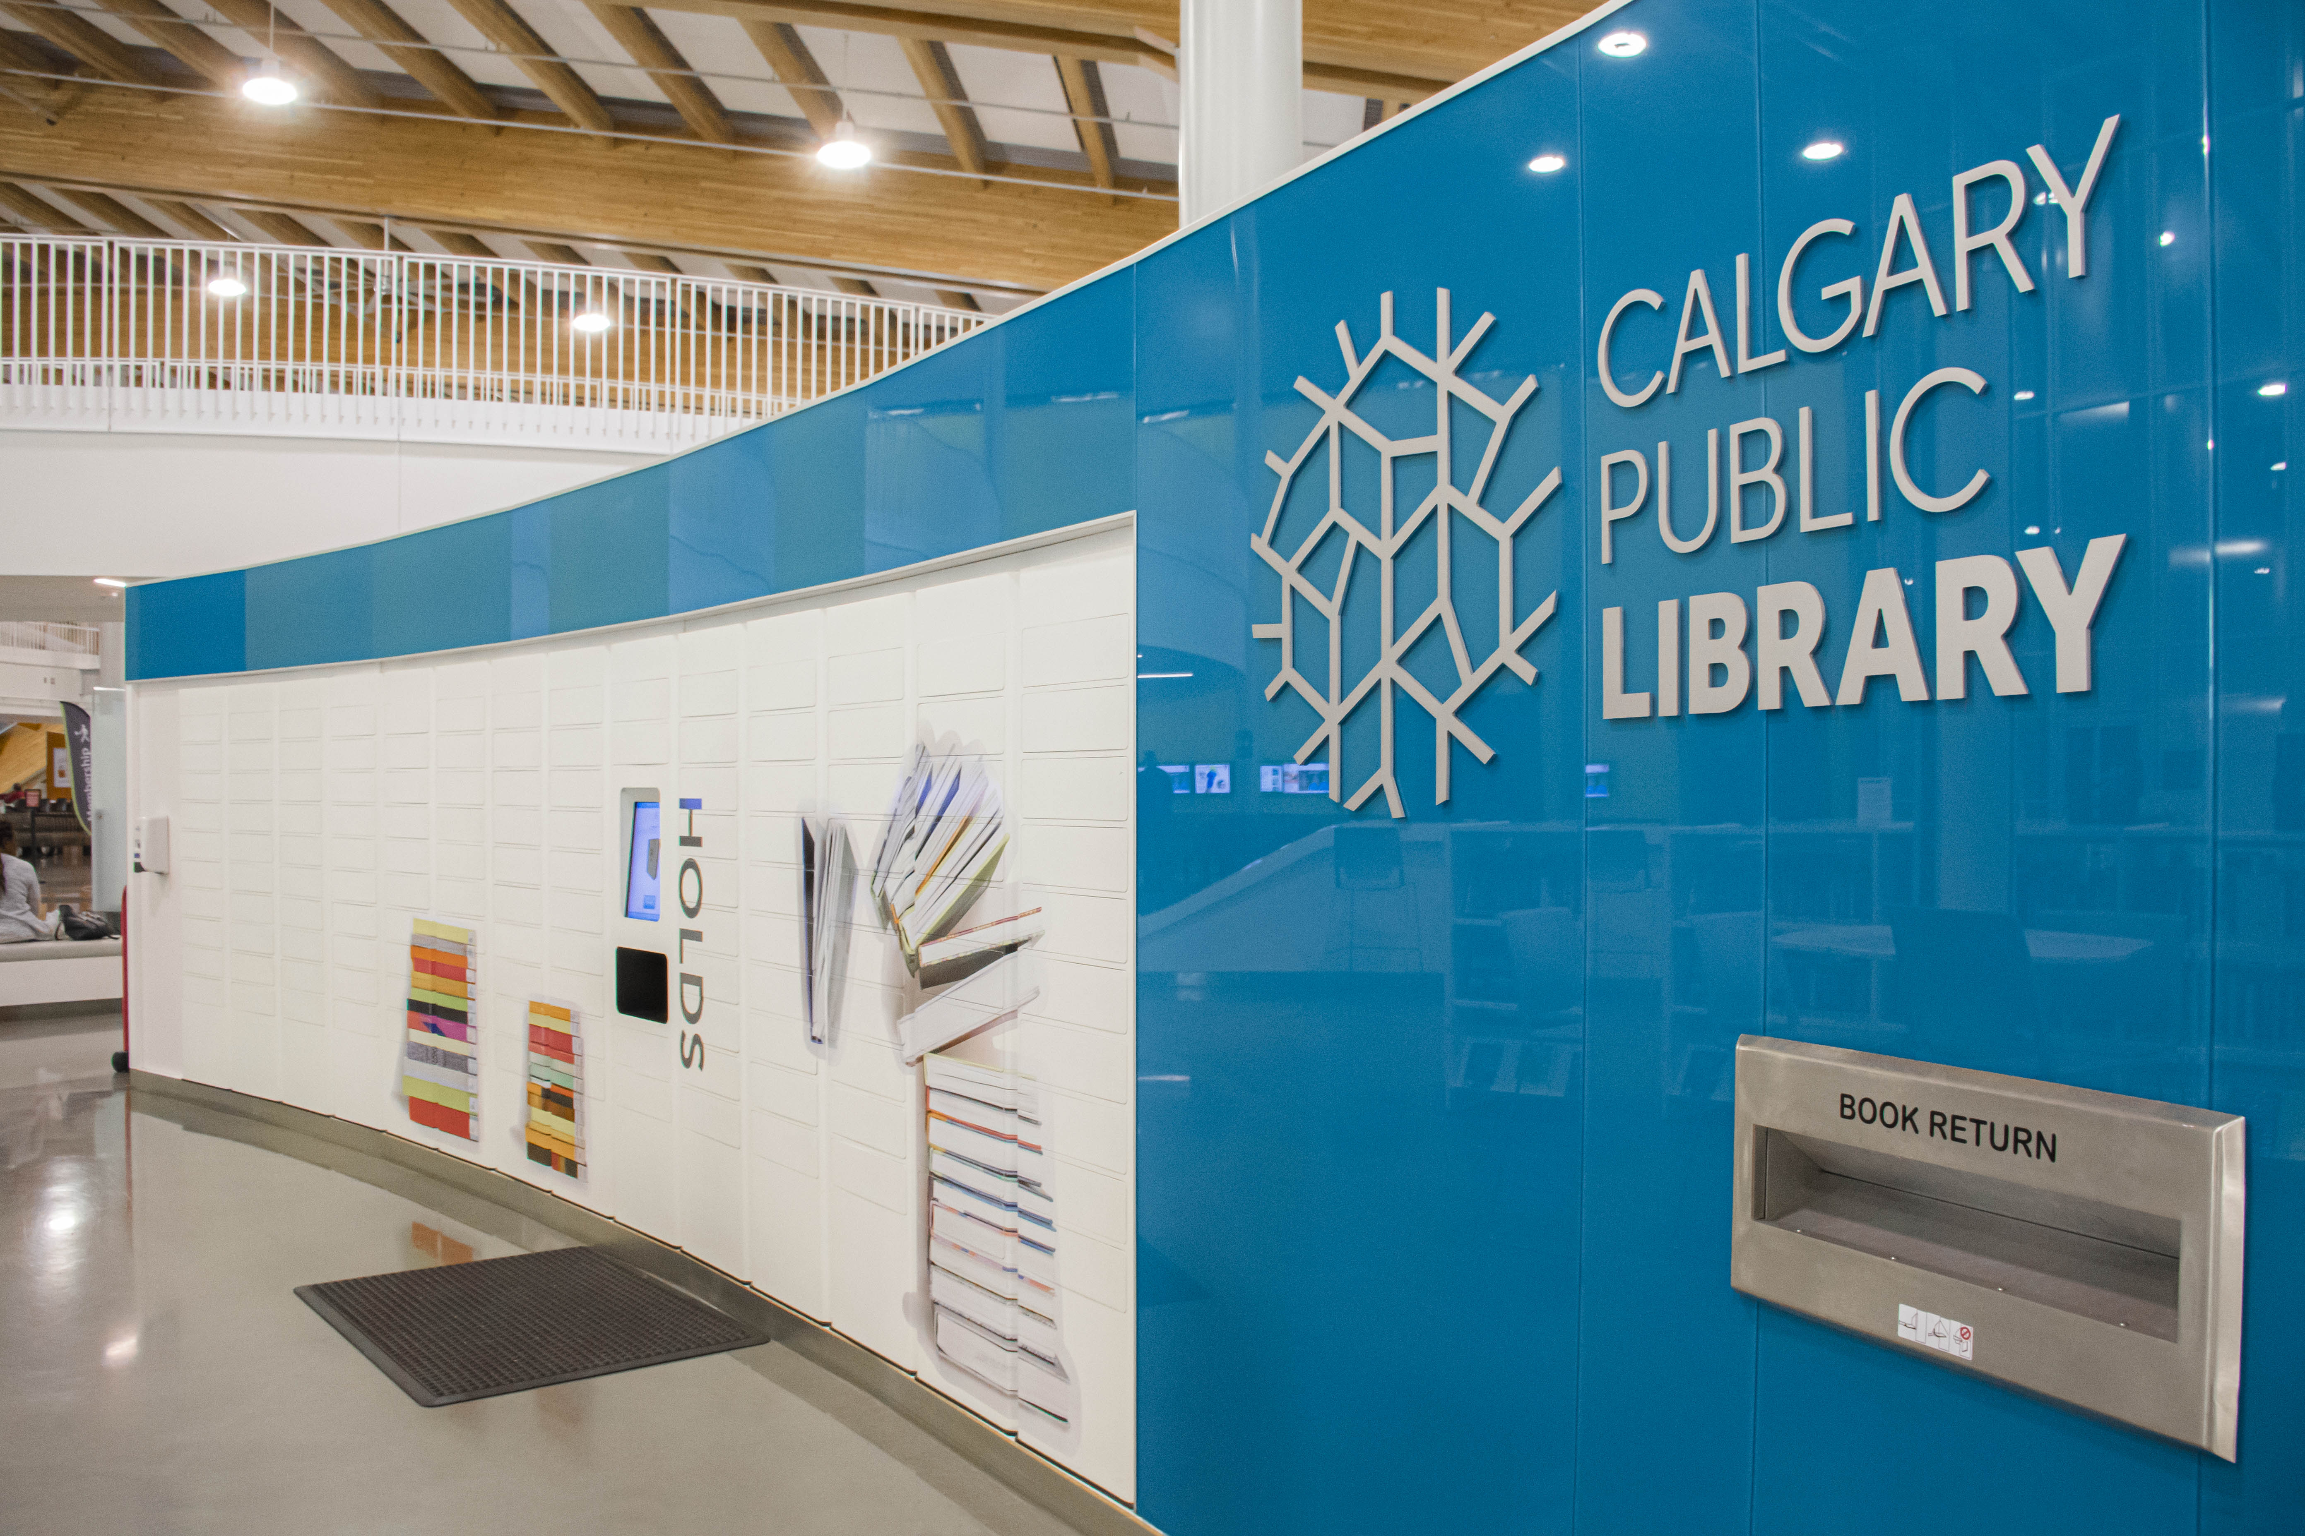
Rationale

Slide 5
How We Got Started
IT Project → Cross-department
Built on existing resources
Small working team
Limited testing before launch

Slide 6
How does it work?
AI requires data input
Combines machine learning with natural language processing
Training process
Multi-platform

Slide 7
From There to Here
B
C
A

Slide 8
Limitations of AI
AI struggles with:
Fact Finding
Wayfinding
Differences in terms/vagueness
Content which often changes
Trolling/Rudeness

Slide 9
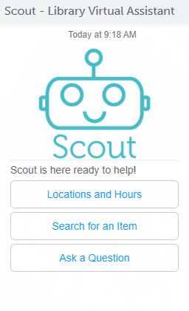
Demo Time!

Slide 10
Considerations & Challenges
Style/Tone/Verbage to use
Scope (ie: what kind/how much data to enter)
Size and type of team
Attempts to respond to every type of question
Library as Google
AI personality

Slide 11
Activity!
Take a few moments and work with the others at your table to brainstorm how many ways people could ask about:
Programs
Services
Collections

Slide 12
Key Learnings
Vendor selection
Define a clear project plan early on
Decide your team and your scope
Really clearly delineate roles and responsibilities
Be flexible always

Slide 13
Why on earth?
It’s new and exciting!
This is knowledge management
Lends itself to library work, cataloguing
Increases capacity to reach patrons 24/7 and respond to service questions anywhere, anytime
Bringing the library to new frontiers/expanding library services – AI platform has allowed us to expand into Facebook/Alexa
No real cap on where you can go

Slide 14
Thank You!
Questions?
Contact us at:
barb.gillard@calgarylibrary.ca
chelsea.murray@calgarylibrary.ca

